Slide 1
Azure Cloud Storage
The principles behind Azure Cloud Storage usage within the .Net C# environment.

Slide 2
What is Azure Cloud Storage
Azure Storage is Microsoft's cloud storage solution for modern data storage scenarios. Azure Storage offers a massively scalable object store for data objects, a file system service for the cloud, a messaging store for reliable messaging, and a NoSQL store.

Slide 3
Azure Storage is:
Durable and highly available. Redundancy ensures that your data is safe in the event of transient hardware failures. You can also opt to replicate data across datacenters or geographical regions for additional protection from local catastrophe or natural disaster. Data replicated in this way remains highly available in the event of an unexpected outage.
Secure. All data written to Azure Storage is encrypted by the service. Azure Storage provides you with fine-grained control over who has access to your data.
Scalable. Azure Storage is designed to be massively scalable to meet the data storage and performance needs of today's applications.
Managed. Microsoft Azure handles hardware maintenance, updates, and critical issues for you.
Accessible. Data in Azure Storage is accessible from anywhere in the world over HTTP or HTTPS. Microsoft provides client libraries for Azure Storage in a variety of languages, including .NET, Java, Node.js, Python, PHP, Ruby, Go, and others, as well as a mature REST API. Azure Storage supports scripting in Azure PowerShell or Azure CLI. And the Azure portal and Azure Storage Explorer offer easy visual solutions for working with your data.

Slide 4
Azure Storage services
Azure Storage includes these data services:
Azure Blobs
A massively scalable object store for text and binary data.
Azure Files
Managed file shares for cloud or on-premises deployments.
Azure Queues
A messaging store for reliable messaging between application components.
Azure Tables
A NoSQL store for schemaless storage of structured data.

Slide 5
Blob storage
Azure Blob storage is Microsoft's object storage solution for the cloud. Blob storage is optimized for storing massive amounts of unstructured data, such as text or binary data.
Blob storage is ideal for:
Serving images or documents directly to a browser.
Storing files for distributed access.
Streaming video and audio.
Storing data for backup and restore, disaster recovery, and archiving.
Storing data for analysis by an on-premises or Azure-hosted service.
Objects in Blob storage can be accessed from anywhere in the world via HTTP or HTTPS. Users or client applications can access blobs via URLs, the Azure Storage REST API, Azure PowerShell, Azure CLI, or an Azure Storage client library. The storage client libraries are available for multiple languages, including .NET, Java, Node.js, Python, PHP, and Ruby.

Slide 6
Azure Files
Azure Files enables you to set up highly available network file shares that can be accessed by using the standard Server Message Block (SMB) protocol. That means that multiple VMs can share the same files with both read and write access. You can also read the files using the REST interface or the storage client libraries.
One thing that distinguishes Azure Files from files on a corporate file share is that you can access the files from anywhere in the world using a URL that points to the file and includes a shared access signature (SAS) token. You can generate SAS tokens; they allow specific access to a private asset for a specific amount of time.

Slide 7
Common Scenarios
Many on-premises applications use file shares. This feature makes it easier to migrate those applications that share data to Azure. If you mount the file share to the same drive letter that the on-premises application uses, the part of your application that accesses the file share should work with minimal, if any, changes.
Configuration files can be stored on a file share and accessed from multiple VMs. Tools and utilities used by multiple developers in a group can be stored on a file share, ensuring that everybody can find them, and that they use the same version.
Diagnostic logs, metrics, and crash dumps are just three examples of data that can be written to a file share and processed or analyzed later.
At this time, Active Directory-based authentication and access control lists (ACLs) are not supported, but they will be at some time in the future. The storage account credentials are used to provide authentication for access to the file share. This means anybody with the share mounted will have full read/write access to the share.

Slide 8
Queue storage
The Azure Queue service is used to store and retrieve messages. Queue messages can be up to 64 KB in size, and a queue can contain millions of messages. Queues are generally used to store lists of messages to be processed asynchronously.
For example, say you want your customers to be able to upload pictures, and you want to create thumbnails for each picture. You could have your customer wait for you to create the thumbnails while uploading the pictures. An alternative would be to use a queue. When the customer finishes their upload, write a message to the queue. Then have an Azure Function retrieve the message from the queue and create the thumbnails. Each of the parts of this processing can be scaled separately, giving you more control when tuning it for your usage.

Slide 9
Table storage
Azure Table storage is a service that stores structured NoSQL data in the cloud, providing a key/attribute store with a schemaless design. Because Table storage is schemaless, it's easy to adapt your data as the needs of your application evolve. Access to Table storage data is fast and cost-effective for many types of applications, and is typically lower in cost than traditional SQL for similar volumes of data.
You can use Table storage to store flexible datasets like user data for web applications, address books, device information, or other types of metadata your service requires. You can store any number of entities in a table, and a storage account may contain any number of tables, up to the capacity limit of the storage account.

Slide 10
What is Table storage?
Azure Table storage stores large amounts of structured data. The service is a NoSQL datastore which accepts authenticated calls from inside and outside the Azure cloud. Azure tables are ideal for storing structured, non-relational data. Common uses of Table storage include:
Storing TBs of structured data capable of serving web scale applications
Storing datasets that don't require complex joins, foreign keys, or stored procedures and can be denormalized for fast access
Quickly querying data using a clustered index
Accessing data using the OData protocol and LINQ queries with WCF Data Service .NET Libraries
You can use Table storage to store and query huge sets of structured, non-relational data, and your tables will scale as demand increases.

Slide 11
Table Storage Concepts
Account
Table
Entity
Name = …
Email = …
Customers
Name = …
Email = …
@Solution
Photo ID =…
Date = …
Photos
Photo ID = …
Date = …
Notes:
Slide Objectives
Understand Tables
Speaker Notes
The Table service provides structured storage in the form of tables.
The Table service supports a REST API that is compliant with the ADO.NET Data Services REST API.
Developers may also use the .NET Client Library for ADO.NET Data Services to access the Table service.
Notes
http://msdn.microsoft.com/en-us/library/dd573356.aspx

Slide 12
Table Properties
URL format:
Azure Table Storage accounts use this format:
http://<storage account>.table.core.windows.net/<table>
Azure Cosmos DB Table API accounts use this format:
http://<storage account>.table.cosmosdb.azure.com/<table>
Accounts: All access to Azure Storage is done through a storage account.
Table: A table is a collection of entities. Tables don't enforce a schema on entities, which means a single table can contain entities that have different sets of properties.
Entity: An entity is a set of properties, similar to a database row. An entity in Azure Storage can be up to 1MB in size. An entity in Azure Cosmos DB can be up to 2MB in size.
Properties: A property is a name-value pair. Each entity can include up to 252 properties to store data. Each entity also has three system properties that specify a partition key, a row key, and a timestamp. Entities with the same partition key can be queried more quickly, and inserted/updated in atomic operations. An entity's row key is its unique identifier within a partition.

Slide 13
Entity Properties
Entity can have up to 255 properties
Up to 1MB per entity
Mandatory Properties for every entity
PartitionKey & RowKey (only indexed properties)
Uniquely identifies an entity
Defines the sort order
Timestamp
Optimistic Concurrency
Exposed as an HTTP Etag
No fixed schema for other properties
Each property is stored as a <name, typed value> pair
No schema stored for a table
Properties can be the standard .NET types
String, binary, bool, DateTime, GUID, int, int64, and double
Notes:
Slide Objectives
Understand Tables and Entities
Speaker Notes
Tables store data as entities.
An entity is a collection of named properties and their values, similar to a row- not an RDBMS though
Tables are partitioned to support load balancing across storage nodes.
Each table has as its first property a partition key that specifies the partition an entity belongs to.
The second property is a row key that identifies an entity within a given partition.
The combination of the partition key and the row key forms a primary key that identifies each entity uniquely within the table.
The Table service does not enforce any schema.
A developer may choose to implement and enforce a schema on the client side
Notes
http://msdn.microsoft.com/en-us/library/dd573356.aspx
http://msdn.microsoft.com/en-us/library/dd179338.aspx

Slide 14
Purpose of the PartitionKey
Entity Locality
Entities in the same partition will be stored together
Efficient querying and cache locality
Endeavour to include partition key in all queries
Entity Group Transactions
Atomic multiple Insert/Update/Delete in same partition in a single transaction
Table Scalability
Target throughput – 500 tps/partition, several thousand tps/account
Windows Azure monitors the usage patterns of partitions
Automatically load balance partitions
Each partition can be served by a different storage node
Scale to meet the traffic needs of your table
Notes:
Slide Objectives
Understand The Partition Key
Speaker Notes
Tables are partitioned to support load balancing across storage nodes.
A table's entities are organized by partition.
A partition is a consecutive range of entities possessing the same partition key value.
The partition key is a unique identifier for the partition within a given table, specified by the PartitionKey property.
The partition key forms the first part of an entity's unique identifier within the table.
The partition key may be a string value up to 1 KB in size.
You must include the PartitionKey property in every insert, update, and delete operation.
Notes
http://msdn.microsoft.com/en-us/library/dd573356.aspx
http://blogs.msdn.com/b/windowsazurestorage/archive/2010/05/07/understanding-the-scalability-availability-durability-and-billing-of-windows-azure-storage.aspx
http://blogs.msdn.com/b/windowsazurestorage/archive/2010/05/10/windows-azure-storage-abstractions-and-their-scalability-targets.aspx

Slide 15
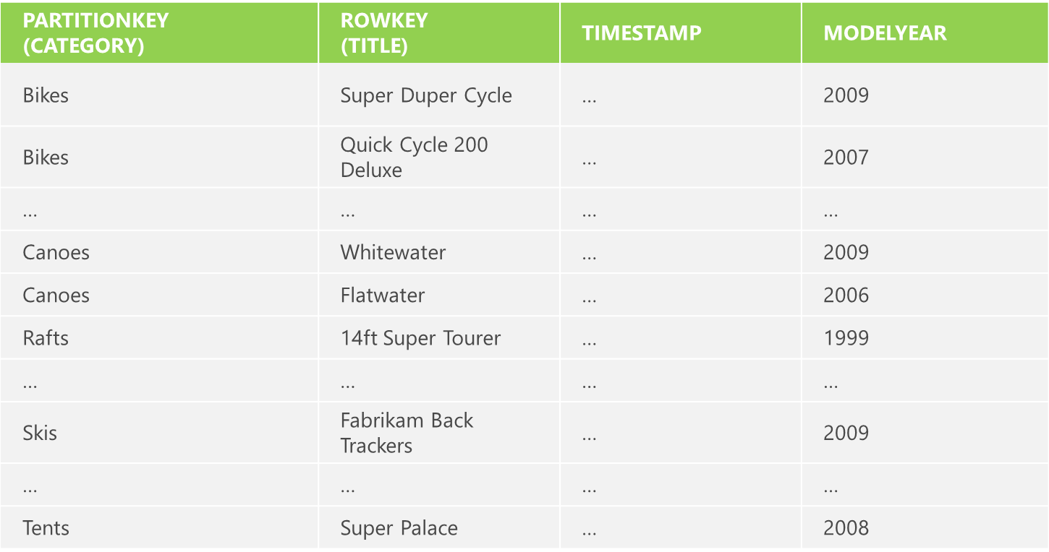
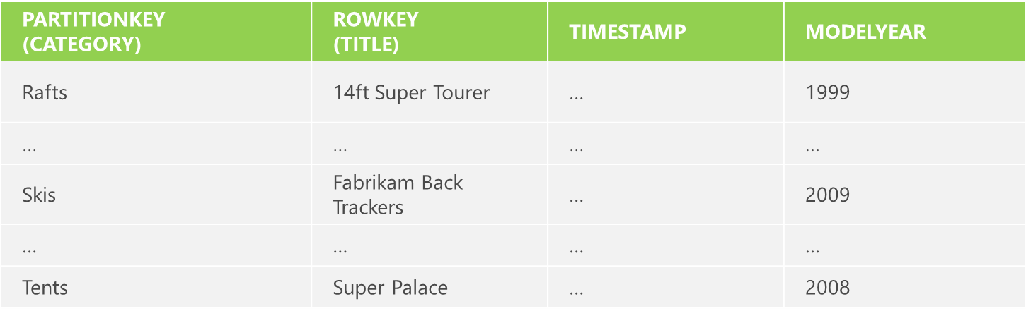
Partitions and Partition Ranges
Server A
Table = Products
[MinKey - Canoes)
Server B
Table = Products
[Canoes - MaxKey)
Notes:
Slide Objectives
Understand Partition Ranges
Speaker Notes
DON’T use unique PartionKey values for your entities – each entity will then belong to its own partition
Range partitions group entities that have sequentially, unique PartitionKey values to improve the performance of range queries.
Without range partitions, a range query will need to cross partition boundaries or server boundaries, which can decrease the performance of the query.
Notes

